Slide 1
Simplifying and Solving Equations
Lesson 4.6
Simplify and solve equations with variables on one side of an equation.

Slide 2
Warm-Up
Solve each equation. Check your solution.
1. 8x – 3 = 21
x = 3
2. –10 = 2x – 6
x = –2
3. 5(x + 4) = 55
x = 7
4. 33 = –3(x – 1)
x = –10

Slide 3
Explore! Equation Manipulation
Step 1
If you do not have an equation mat, draw one on a blank sheet of paper. On your equation mat, model the equation 4x + 7 + x − 3 = −1
Remember:
x
= 1x (or, x)
= 1
= –1
Step 2
Looking at your equation mat, is there a way you can simplify either side of the equation? If so, rewrite the equation.
Step 3
Solve the equation using your mat. What does x equal?

Slide 4
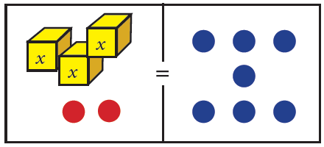
Explore! Equation Manipulation
Step 4
Look at the equation mat at the right and determine which of the equations below is represented on the mat. Explain why you chose the one you did and find the solution to the equation.
Equation #1 −2 + 2x + 4 + 2x = 7
Equation #2 −7 + 2x + 5 + x = 7
Equation #3 3x + 2x − 3 + 1 = 7
Step 5
Explain in words how to simplify an algebraic equation before solving.
Step 6
Use the equation mat to solve the equation shown on the mat above.

Slide 5
Simplifying and Solving Equations with Like Terms
Using the Distributive Property, rewrite the equation without parentheses.
Combine all like terms that are on the same side of the equation.
Solve the remaining one- or two-step equation by using inverse operations to isolate the variable.

Slide 6
Example 1
Solve the equation for the variable. Check your solution.
a. 3m + 6 – 8m + 9 = –20
Write the equation. Group like terms. Combine like terms.
Subtract 15 from both sides. Divide both sides of the equation by (–5).
3m + 6 – 8m + 9 = –20
3m – 8m + 6 + 9 = –20
–5m + 15 = –20
– 15 – 15
–5m = –35
–5 –5
m = 7
3(7) + 6 – 8(7) + 9 –20
21 + 6 – 56 + 9 –20
–20 –20
Check the solution.
=
=
=

Slide 7
Example 1 Continued…
Solve the equation for the variable. Check your solution.
b. 0 = 4(3x – 2) – 5x + x
Write the equation.
Distribute 4 through the parentheses. Group like terms.
Combine like terms.
Add 8 to both sides of the equation. Divide both sides by 8.
0 = 4(3x – 2) – 5x + x
0 = 12x – 8 – 5x + x
0 = 12x – 5x + x – 8
0 = 8x – 8
+8 + 8
8 = 8x 8 8
1 = x
0 4(3(1) – 2) – 5(1) + (1)
0 4(1) – 5 + 1
0 0
Check the solution.
≟
≟
=

Slide 8
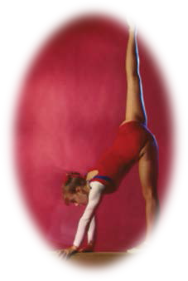
Example 2
Natasha paid $60 to join a gymnastics club for the summer. Each gymnastics class she attended cost $15. Her aunt works at the club so Natasha receives a $4 “Friends and Family” discount per class. Natasha spent $214 on classes for the entire summer. How many classes did she attend?
Let g represent the number of classes which Natasha attended. An equation which models this situation could be written as:
60 + 15g – 4g = 214
Combine like terms. Subtract 60 from both sides. Divide each side by 11.
60 + 11g = 214
–60 –60
11g = 154
11 11
g = 14
Natasha attended 14 gymnastics classes.

Slide 9
Communication Prompt
What is a job that might require the employees to solve equations? Describe.

Slide 10
Exit Problems
Solve each equation. Check your solution.
1. 4(x – 2) + 7 = 35
x = 9
2. 3y + 5 + y + 10y = 19
y = 1

